Slide 1
Building A Quadcopter in 10 Weeks
To achieve great things, two things are needed: a plan and not quite enough time.
--Leonard Bernstein
Homepage: http://goo.gl/XYwuoy

Slide 2
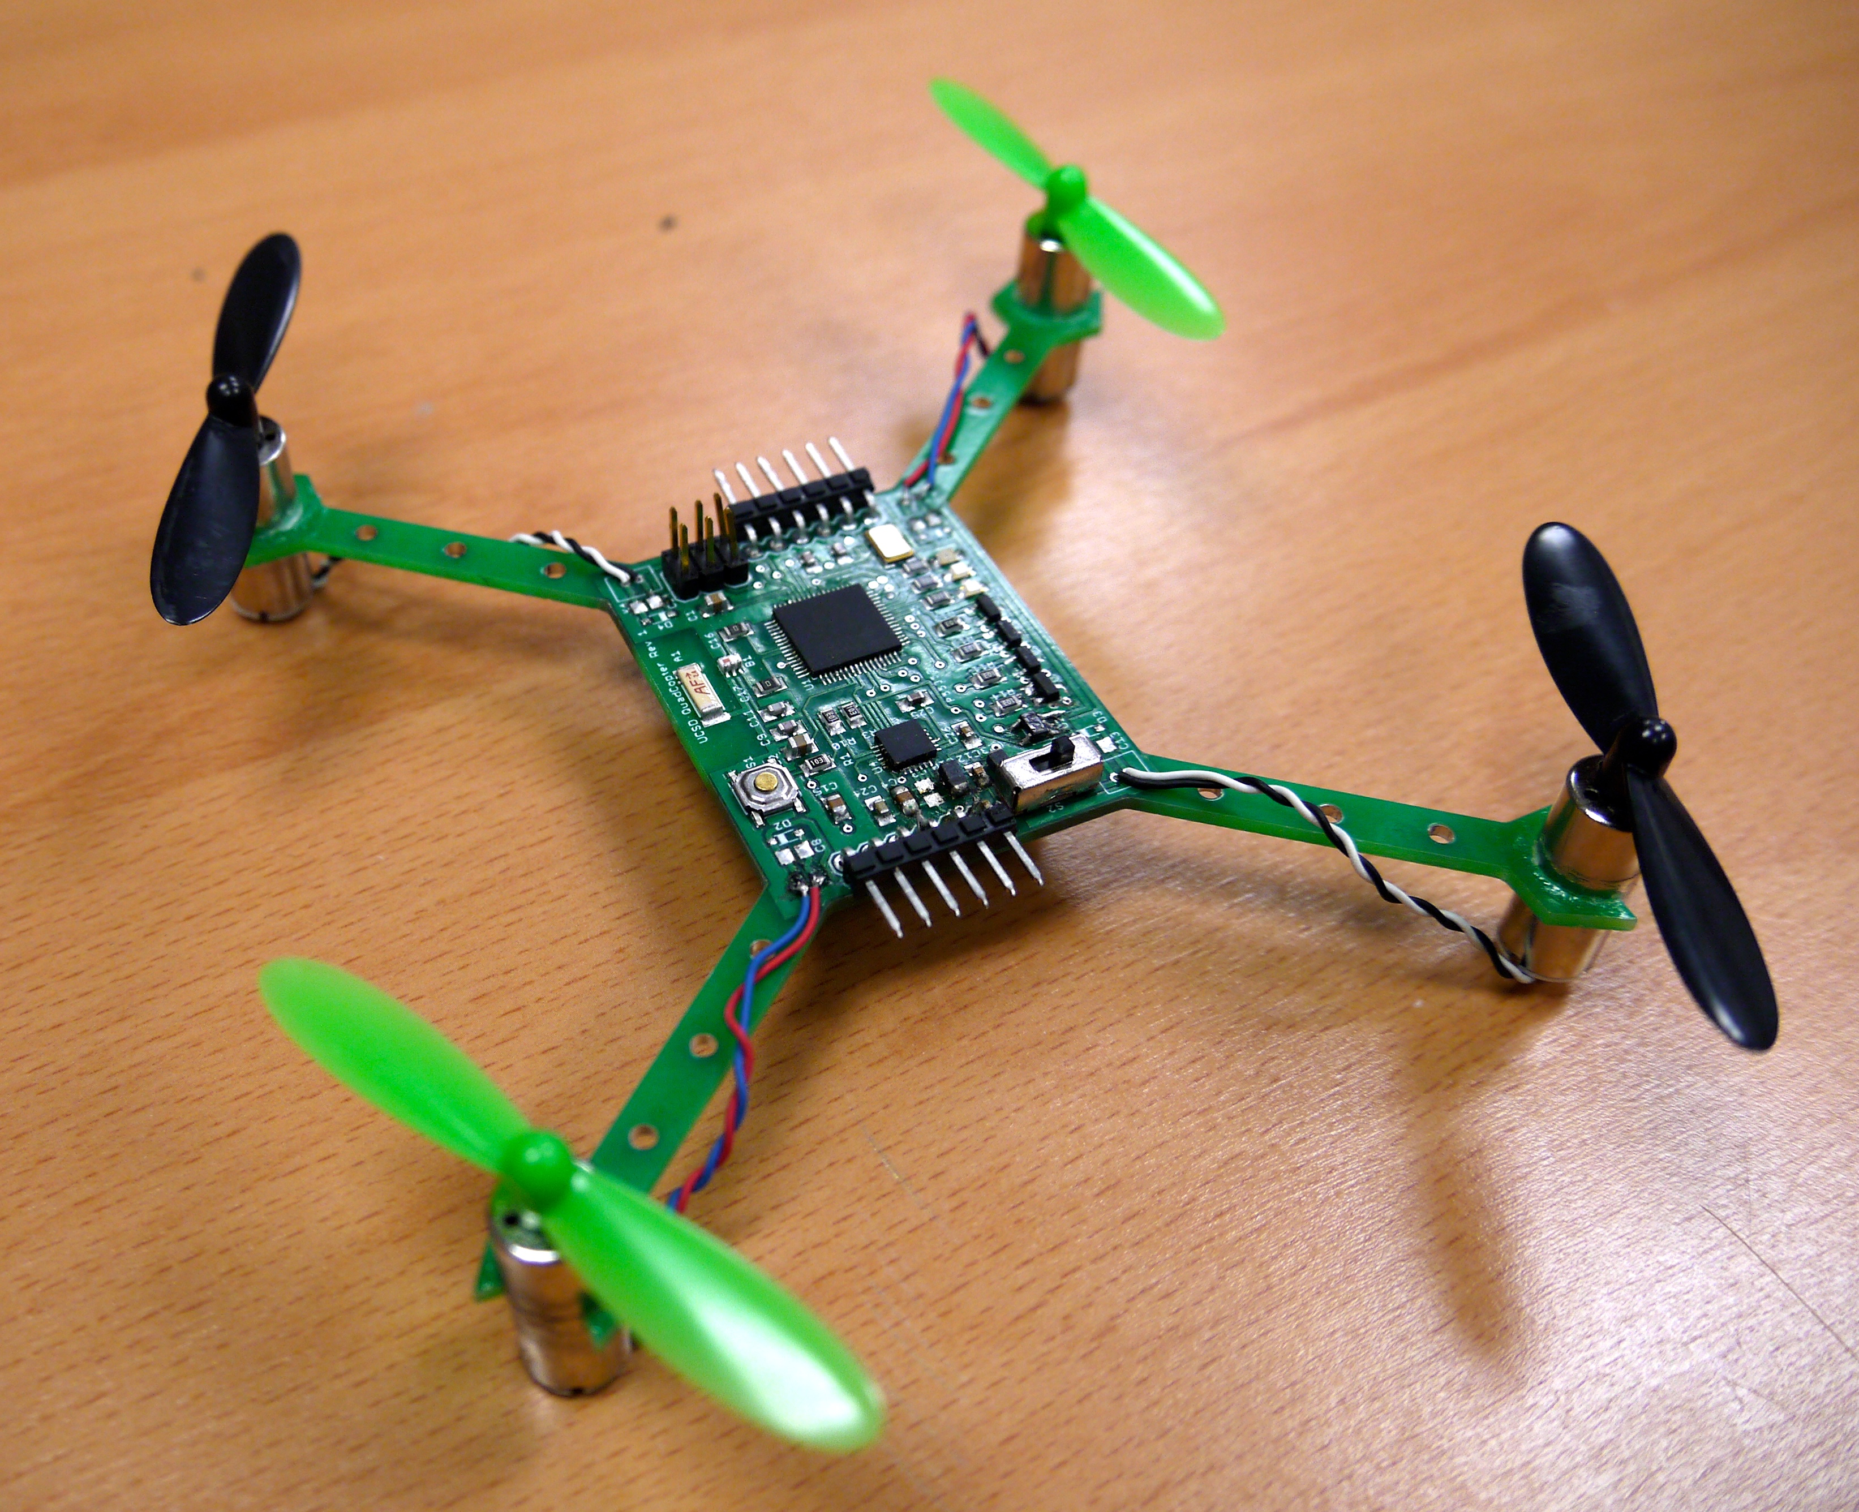
Course Goals
Build several small quadcopter
In 10 weeks
Mostly “from scratch”
Learn
Basic PCB design
How to integrate diverse hardware/software components
About quadcopter-related technologies

Slide 3
Course Schedule Outline
Main goal: Start testing/refining flight control software on your quadcopter ASAP.
Weeks 1-5: Sprint to a PCB design, do preliminary software development
Most important date: May 9th – Board “tape out”
Weeks 6-10: Software refinement, quad assembly, refinement and testing.
Schedule is here: https://goo.gl/LgzvEu

Slide 4
Lab Overviews

Slide 5
The Lab Schedule
The lab schedule is very aggressive
Preparatory labs (1-4): 2 weeks
There’s a new lab each class, and they are due one week later.
You will learn all the skills you need to build the quadcopter
Design and manufacturing labs (4,7,8): 3.5 weeks
Design the schematic and board
Manufacture them.
Implement flight control software (5, 6): 4 weeks
Quadcopter and remote firmware development
PID control for quad stability.
Make it work labs (9-10): 4.5 weeks
Make it fly!
Total: 14 weeks!
Do not fall behind!

Slide 6
Lab Structure
Labs are divided into hardware and software labs
Hardware labs require equipment
We will provide it.
You are responsible for it (see policy on course web site)
Software labs require only software and data
You can use the computers here or your own.

Slide 7
Teams
You will work both in groups and on your own
Lab 1 and 2 will be on your own.
The rest are completed in pairs of your choosing.
In all cases, you can help each other out
No direct copying of source code, designs, etc.
Asking questions, etc. is great.
There is no curve in this class – no need to compete.

Slide 8
Lab 1: Learn to Use Eagle
Software Lab
Build design a simple schematic.
Turn it into a board design.
Generate manufacturing data.
Performance manufacturing checks.
Design some new parts for the Eagle library.
Learn to decorate your boards.
This is due Thursday (in 48 hours!!!)

Slide 9
Lab 2: Practice Using Eagle
Software Lab
Build more parts in Eagle.
The IMU
Some discrete components
Hard: Build all the parts.

Slide 10
Lab 3: Wireless Communication
Hardware Lab
Learn how to use the microcontrollers
Arduino IDE
The microcontroller breakout boards
The radios
Experiments
Measure bandwidth, error rate, and range

Slide 11
Lab 4: Start Designing the Quad
Software Lab
Create the schematic
Start with the breakout board schematic.
Connect the IMU
Connect the motor controller
Assemble the power supply circuit
Followed by design review

Slide 12
Lab 5: Other Quadcopter Components
Hardware Lab
Use the remote control to measure gimbal position
Transmit it to the other red board and control a motor accordingly
Read values from an IMU.

Slide 13
Lab 6: Flight Control Software
Hardware Lab
Implement PID control
Build a remote-controlled, PID-stabilized test stand.

Slide 14
Lab 7: Layout the Board
Software Lab
Define the board outline.
Place your parts.
Route the design.
Followed by design review.
Design review

Slide 15
Lab 8: Tape Out!!!
Software Lab
Your designs must be ready for manufacturing by the beginning of class on May 11th.
Early tape out is possible on May 4th.
It will take about a week to manufacture them.

Slide 16
Lab 9: Assembly and Bringup
Hardware Lab
Solder everything to the board
This is non-trivial. The Microcontroller and IMU are challenging packages.
Install the bootloader
Test all the quad subsystems
IMU
Motors
Power
Radio
Debug, Debug, Debug.

Slide 17
Lab 10: Make it Fly!!!
Software and Hardware Lab
Test, adjust, tweak, debug, etc. until its flight is stable.

Slide 18
Logistics

Slide 19
Lab Materials
We will distribute lab materials via github classroom.
You’ll need a github account.
You’ll need to know how to use git.
To access the lab materials, click on the invitation link included in each lab.

Slide 20
Grades and Stuff
No final or exams.
10 Labs
Grading breakdown
50% class participation
50% labs

Slide 21
This is an Intensive, Hands-on Class
Not so much lecturing
Lots of doing.
Your Task
Work Hard
Figure stuff out
Take the initiative
My and Antonella’s Task
Provide high-level guidance
A few lectures
Make sure you have what you need to succeed.

Slide 22
Lab Space
We will meet and work in this room (EnVision -- SME)
You must complete the responsibility contract: http://makerspace.ucsd.edu/access/responsibility.php
Class: 10-11:30
Lab hours
11:30-1:00 on Tuesday and Thursday
Other times TBD

